Slide 1


2024
GovHack
Using AI and Historical Planning Data to Predict School Site Distribution and Community Development Benefit
Yangxi Chen & Yanqi Meng

Slide 2
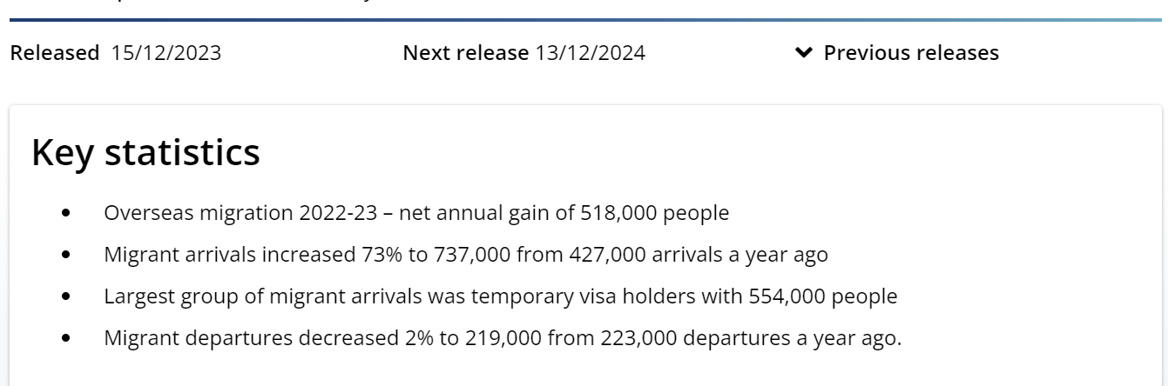
PPT下载 http://www.1ppt.com/xiazai/
01
Introduction
Schools are a key element of the educational process because children spend a great deal of their time there. Well-located, well-designed, safe and efficiently operated schools contribute to social development. Due to the increasing immigration population in Australia in recent years, it is very important to establish new educational institutions and provide corresponding jobs.
We've created a platform to help
governments think about where
to locate new schools.
https://www.abs.gov.au/statistics/people/population/overseas-migration/latest-release

Slide 3
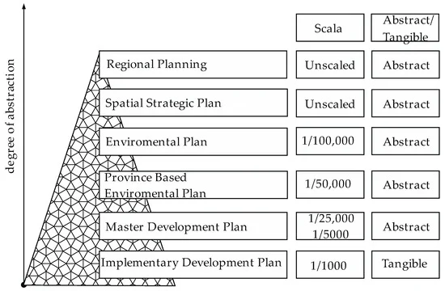
PPT下载 http://www.1ppt.com/xiazai/
02
Materials and Methods
City Planning
As shown in Figure . Zoning planning can be divided into upper planning and sub-planning. The upper plan identifies the main principles related to the planning area. Subplanning, such as the implementation of development plans, involves downsizing on a plot basis. Public authorities build public services such as roads, schools and parks according to sub-plans, while private owners design real estate according to the functions in the zoning plan. In a 1/1000 scale implementation development plan (Implementation Zoning), privately owned real estate is directly related to planning The focus of this study is to determine the location and size of existing or planned school sites prior to the development of an implementation plan in case future problems arise.
https://doi.org/10.3390/ijgi9110662

Slide 4
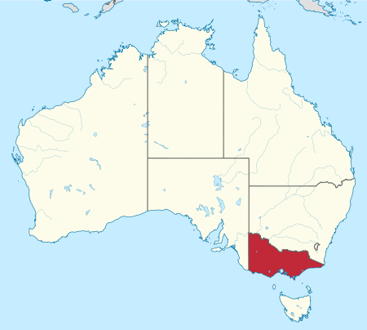
PPT下载 http://www.1ppt.com/xiazai/
02
Materials and Methods
Area
We studied Victoria (state), Australia's second smallest state (after Tasmania), with a land area of 227,444 square kilometres (87,817 square miles); It is the second most populous state after New South Wales, with a population of over 6.7 million; It is also Australia's most densely populated state (29.5 people per square kilometre). Victoria's economy is the second largest of the Australian states, highly diversified and dominated by the service sector. Melbourne is the capital and largest city of Victoria and the second largest city in Australia, home to more than three-quarters of the multicultural population (35.1% of residents are immigrants).
https://en.wikipedia.org/wiki/Victoria_(state)

Slide 5
PPT下载 http://www.1ppt.com/xiazai/
02
Materials and Methods
Educational Facility Area Size
For high-quality international schools with an estimated capacity of 25 students in a room, the following standards are generally applied:
Breakout Spaces
Standard Classroom: minimum 75 m2
Standard Kindergarten Classroom: minimum 95 m2
Standard Science Lab, Art or Drama Room: minimum 95m2
As a general guide, 10 m2 per student is typically allocated for outdoor play and sports areas. By adding the constructed building footprint to the outdoor area, the land requirements can be calculated. For instance, 1500 students may require:
GFA over 2 floors: 15,000 m2 (i.e., 7500-footprint)
Outdoor Areas: 15,000 m2
Total Area: 22,500 m2 or 5.56 Acres.
https://www.linkedin.com/pulse/school-set-up-calculating-required-area-greg-parry/

Slide 6
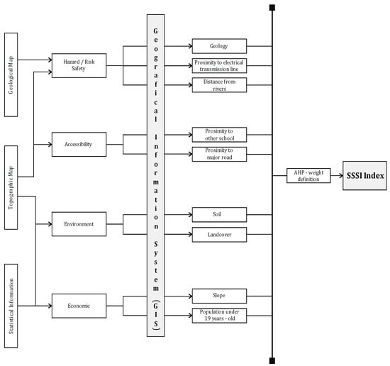
PPT下载 http://www.1ppt.com/xiazai/
02
Materials and Methods
Model
We refer to the model analysis of https://doi.org/10.3390/ijgi9110662 , using GIS index model to determine suitable for the location of the school area, The advanced model performs a multi-criteria decision analysis, which includes the School Location Index (SSSI). The SSSI is designed to help identify suitable school locations.
Parameters in the SSSI
The SSSI consists of nine parameters: distance from river (m), distance from transmission line (m), geology, distance from school (m), distance from main road (m), land use/land cover, soil, population under 19 years (per pixel) and slope (°)
https://doi.org/10.3390/ijgi9110662

Slide 7
PPT下载 http://www.1ppt.com/xiazai/
02
Materials and Methods
School location index parameters
1. Population growth and density
2. Demographics: The proportion of school-age children (usually 5-18 years old) in the community. The percentage of families with children affects school demand.
3. Land use and availability: The amount of land available for development or conversion into schools. Local zoning laws that affect whether land can be used for educational purposes. Other potential uses of the land, such as commercial or residential development.
4. Proximity to existing infrastructure: Proximity to residential areas, good access to roads, highways and public transport, and easy access to the school. Access to basic utilities such as water, electricity and the Internet.
5. Commercial expansion: The growth of businesses and commercial areas around the school can create synergies or conflicts.
6. Socioeconomic factors: Income distribution across the district, which affects school funding and demand. The rate of employment growth may affect demographic changes and housing demand.
7. Environmental and geographical factors

Slide 8
PPT下载 http://www.1ppt.com/xiazai/
03
Interface
We used asp.net in visual studio to create a simple interface, using the B/S architecture
We designed the platform to analyze the following functions:
Land Use and Commercial Expansion Analysis for Schools:
Land Use Change Analysis
School Land Demand Forecast
Competition for Land Use
Commercial Expansion Around Schools
Commercial Opportunities Prediction
Future School Site Recommendations
Housing Demand Forecasting for Schools:
Student Population Growth Analysis
Parental Housing Demand
Faculty Housing Demand
School and Housing Price Correlation
Future Housing Affordability Analysis

Slide 9
PPT下载 http://www.1ppt.com/xiazai/
04
Analyze
In the video

Slide 10
PPT下载 http://www.1ppt.com/xiazai/
05
Reference
1. Coruhlu, Y.E.; Baser, V.; Yildiz, O. Object-based geographical data model for determination of the cemetery sites using SWOT and AHP integration. Surv. Rev. 2020.
2. Coruhlu, Y.E.; Uzun, B.; Yildiz, O. Zoning plan-based legal confiscation without expropriation in Turkey in light of ECHR decisions. Land Use Policy 2020, 95, 104598.
3. Baser, V.; Uzun, B.; Yildirim, V. An alternative method for expropriation for lane-like projects in planned area: A case study from Trabzon in Turkey. Surv. Rev. 2019, 51, 147–153.
4. Thériault, M.; Le Berre, I.; Dubé, J.; Maulpoix, A.; Vandersmissen, M.H. The effects of land use planning on housing spread: A case study in the region of Brest, France. Land Use Policy 2020, 92, 104428.
5. Barton, H. Land use planning and health and well-being. Land Use Policy 2009, 26, S115–S123.
6. Bukhari, Z.; Rodzi, A.; Noordin, A. Spatial multi-criteria decision analysis for safe school site selection. Int. Geoinform. Res. Dev. J. 2010, 1, 1–14.
7. McDonald, N.C. School siting: Contested visions of the community school. J. Am. Plan. Assoc. 2010, 76, 184–198.
8. Jamal, I. Multi-criteria GIS analysis for school site selection in Gorno-Badakhshan Autonomous Oblast, Tajikistan. Master’s Thesis, Geographical Information Science, Lund University, Lund, Sweden, 2016.
9. Ali, K.A. Multi-Criteria Decision Analysis for Primary School Site Selection in Al-Mahaweel district Using GIS Technique. J. Kerbala Univ. 2018, 16, 342–350.

Slide 11
PPT下载 http://www.1ppt.com/xiazai/
Thanks for your watching!

